Slide 1
LOAN APPLICATION MANAGEMENT SYSTEM
Batch 6, Group 6

Slide 2
OUR USPs
Our proposed system
Asks for minimal information.
Offers seamless and clean UI: Superior user experience.
Auto approval on loan application.
The Admin can
Add/update type of loans, employee and possible items to the database.
They can watch all the loans taken by employees for easier access.
The Employee can
Automatically get quotation of item amount and duration as soon as they select item and category.
Only show active loans.

Slide 3






TECH STACK
Backend
Frontend
Testing
Database

Slide 4
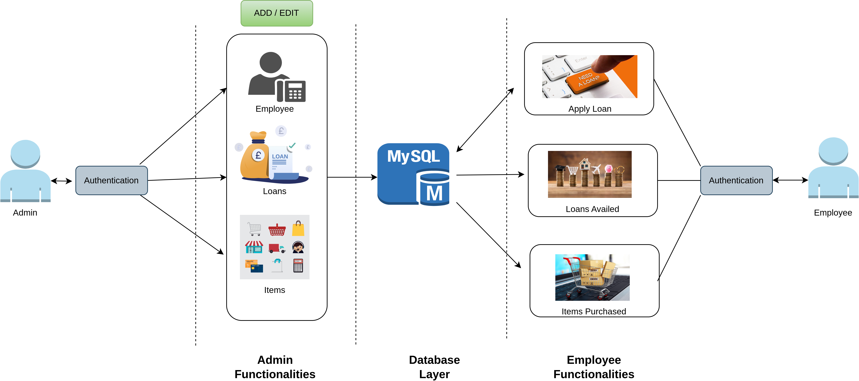
ARCHITECTURE DIAGRAM

Slide 5
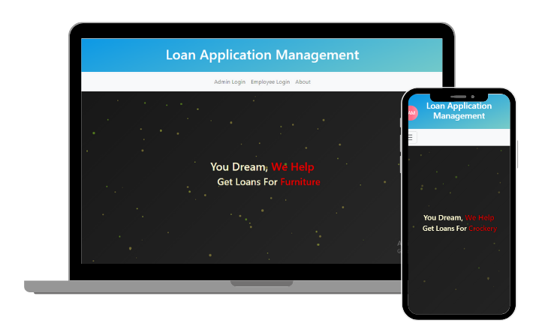
RESPONSIVE INTERFACE

Slide 6
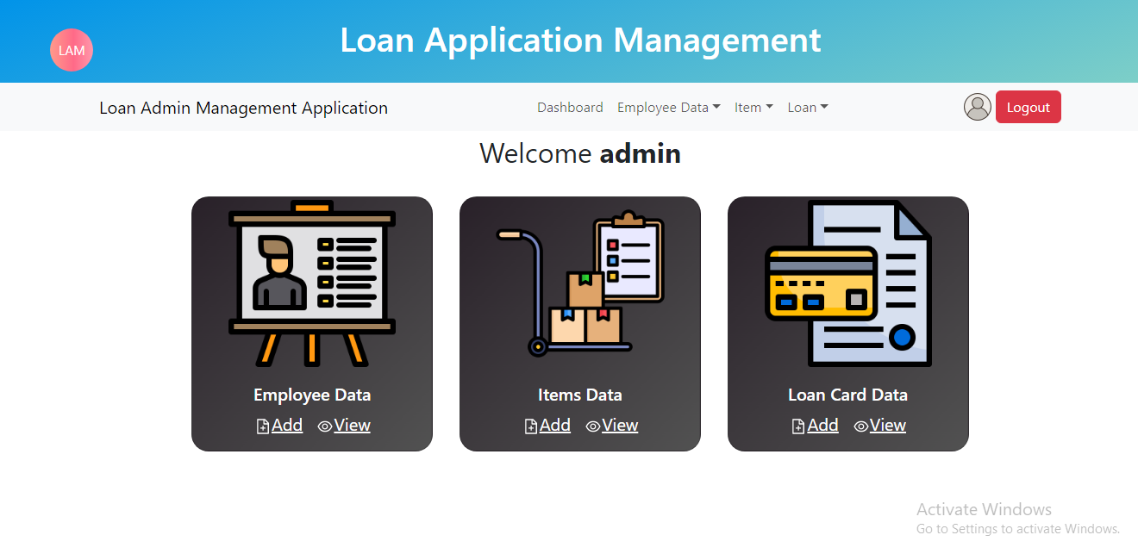
USER FRIENDLY INTERFACE (ADMIN DASHBOARD)

Slide 7
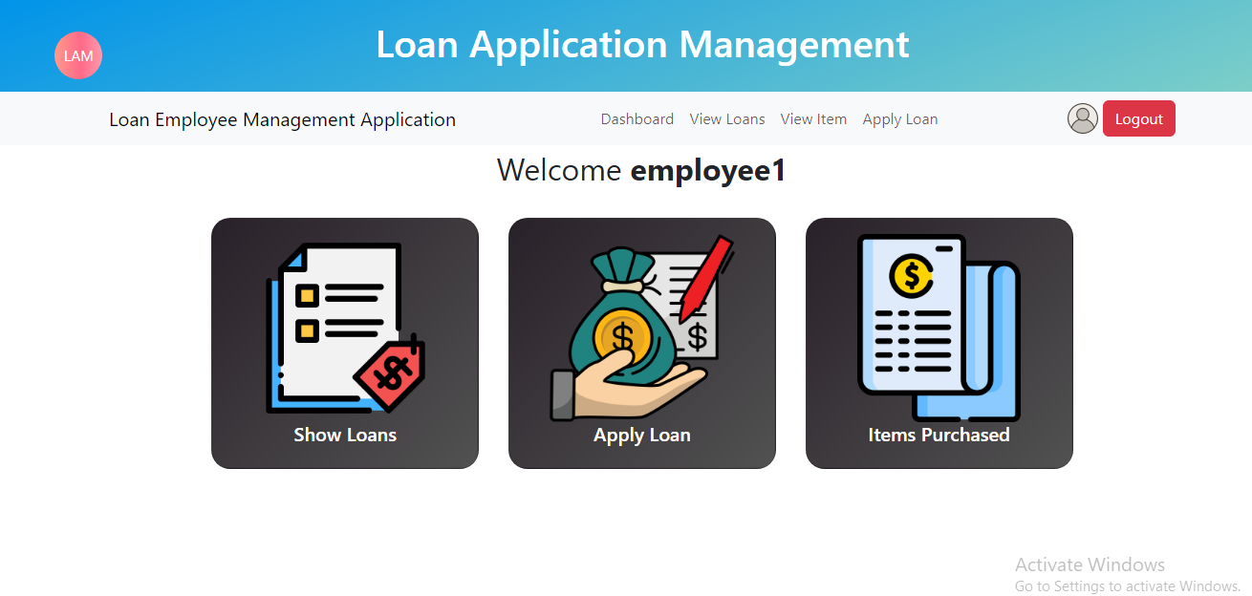
USER FRIENDLY INTERFACE (EMPLOYEE DASHBOARD)

Slide 8
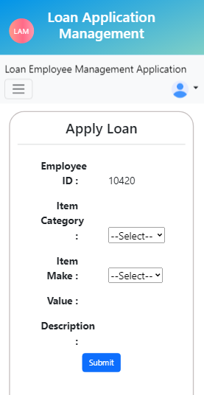
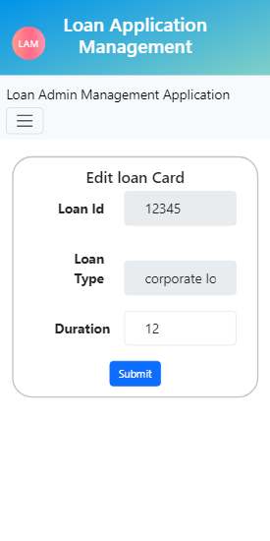
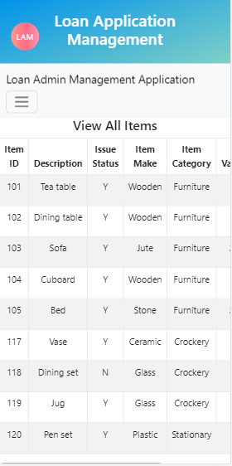
LOAN AND ITEM FUNCTIONALITY

Slide 9
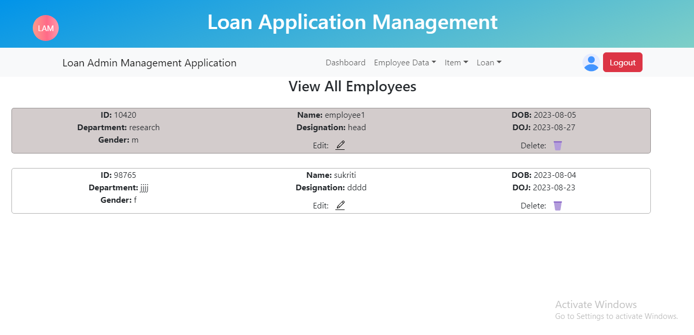
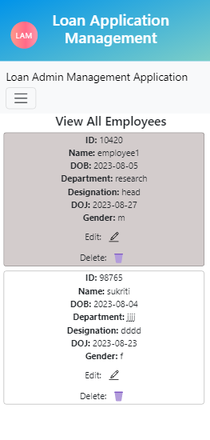
VIEW EMPLOYEE

Slide 10
VALIDATION
BACKEND VALIDATION
Validation to check for empty or invalid input to columns of database
Raise exceptions and handle them
FRONTEND VALIDATION
Check for invalid input to form fields
Prompt user to correct it

Slide 11
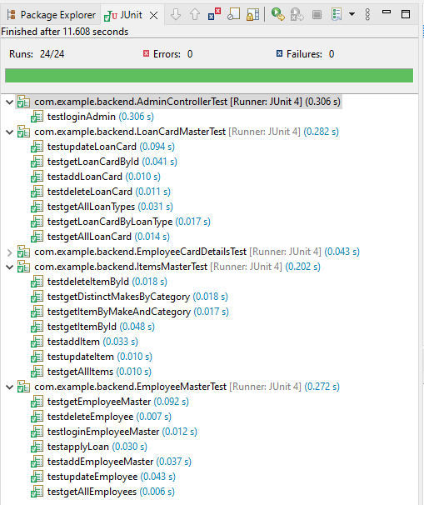
TESTING
BACKEND TESTING
JUnit uses MockMvc class to test the controllers

Slide 12
FUTURE SCOPE
USER EXPERIENCE ENHANCEMENT
Add chat bot for basic questions regarding the loan application process for the users
Improve session management and secure endpoints
SECURITY
For increased security, we can use login with OTP along with password encryption
Auto approval can be modified to a two step process – Background check followed by approval
Credit score integration

Slide 13
CHALLENGES AND LEARNING
Front-end and back-end application integration
Learning an entire new development framework
Ability to divide work among team members and complete task on time

Slide 14
THANK YOU!

